Slide 1

STA324 The Foundations and Applications of Large Language Models
2025-2026 Spring Semester
Linyi Yang
Lecture 1 2026/02/27

Slide 2
Outline
E1. Environment Setup for Large Language Models
E1.1 Environments Setup
E1.2 Large Language Model in Website
E1.3 Large Language Model in Terminal (e.g. Claude Code)
E1. Environment Setup for Large Language Models

Slide 3
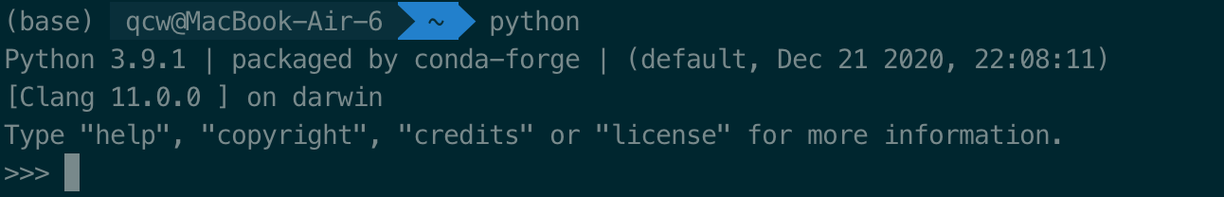
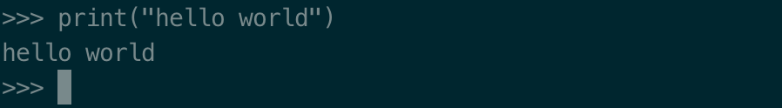
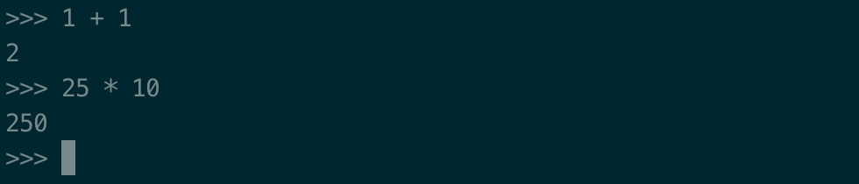

Python Setup
Download and install Python for running codes
https://www.python.org/downloads/
interactive Python interface
E1. Environment Setup for Large Language Models

Slide 4
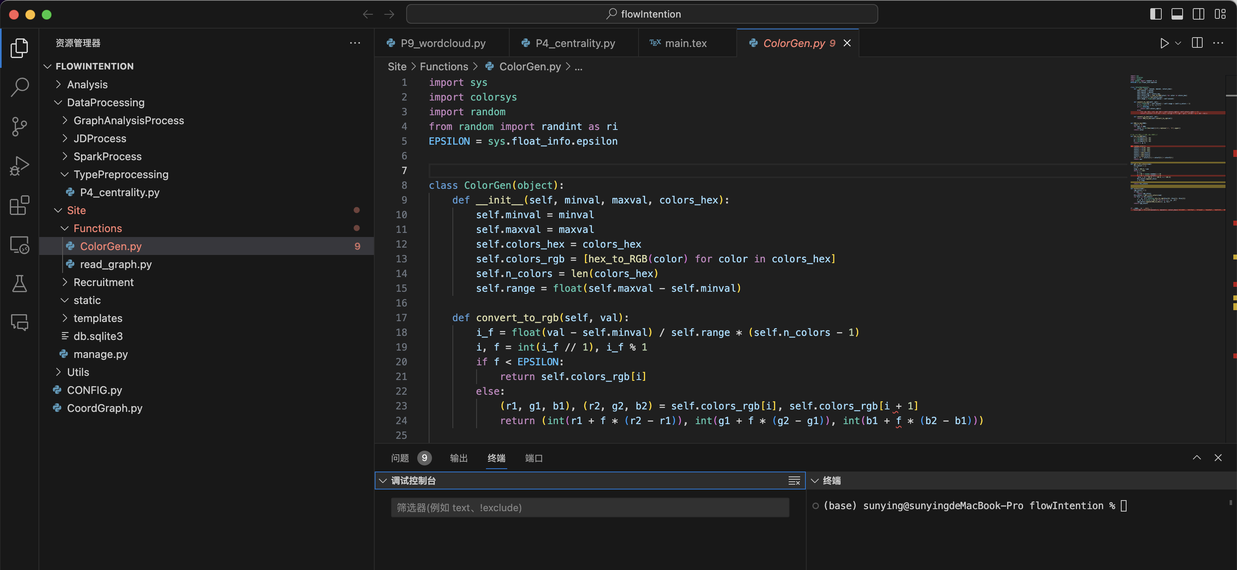
Python Setup
Download Integrated Development Environment (IDE) for developing ( writing / debugging …) codes
PyCharm / Visual Studio Code
Instead of interactive coding, we need to write script first, and then running code by "python xxx.py"
E1. Environment Setup for Large Language Models

Slide 5
Python Setup
Why use an IDE? It makes coding easier by offering:
Syntax highlighting: keywords and errors are clearly marked
Auto completion: helps you finish code faster
Debugging tools: step through your program to find mistakes
Project/file management: organized workspace for code
Environment management: easily manage libraries and dependencies
Remote server connection: run and test code on other machines
E1. Environment Setup for Large Language Models

Slide 6
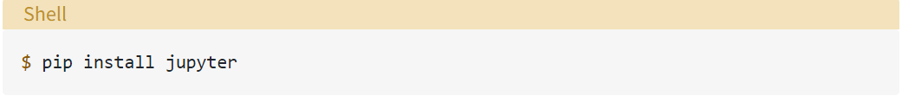
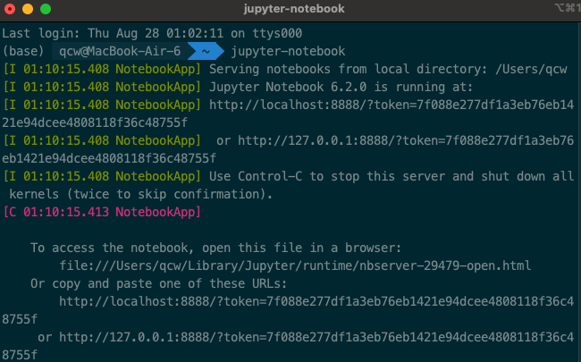
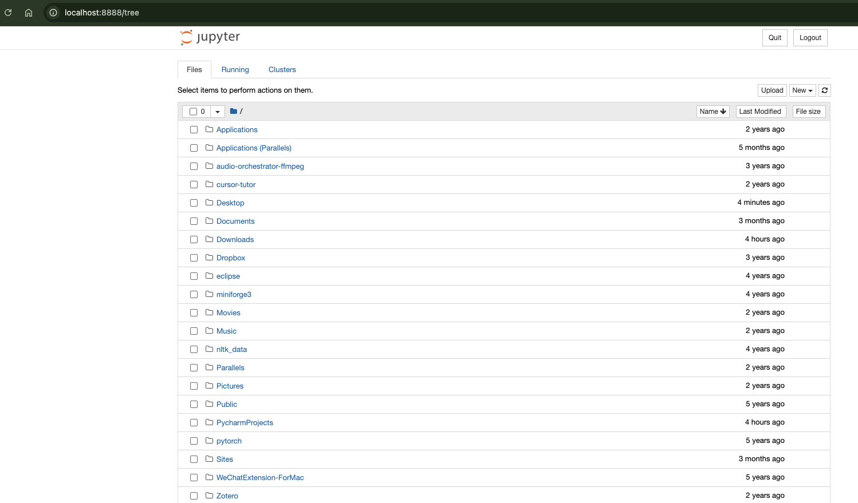
Getting started with Jupyter Notebook
Install Jupyter Notebook on your machine
Run Jupyter Notebook from your terminal
Open the Notebook interface in your web browser
E1. Environment Setup for Large Language Models

Slide 7
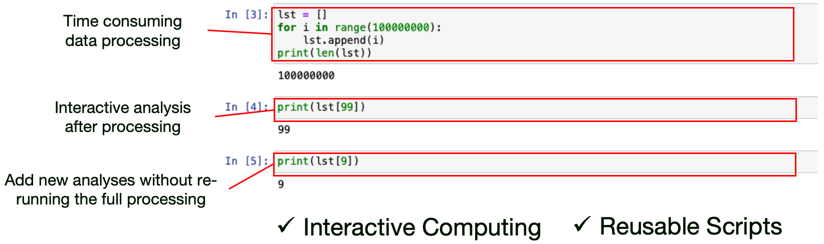
Jupyter Notebook
Hybrid approach: combine script and interactive modes by coding in blocks
E1. Environment Setup for Large Language Models

Slide 8
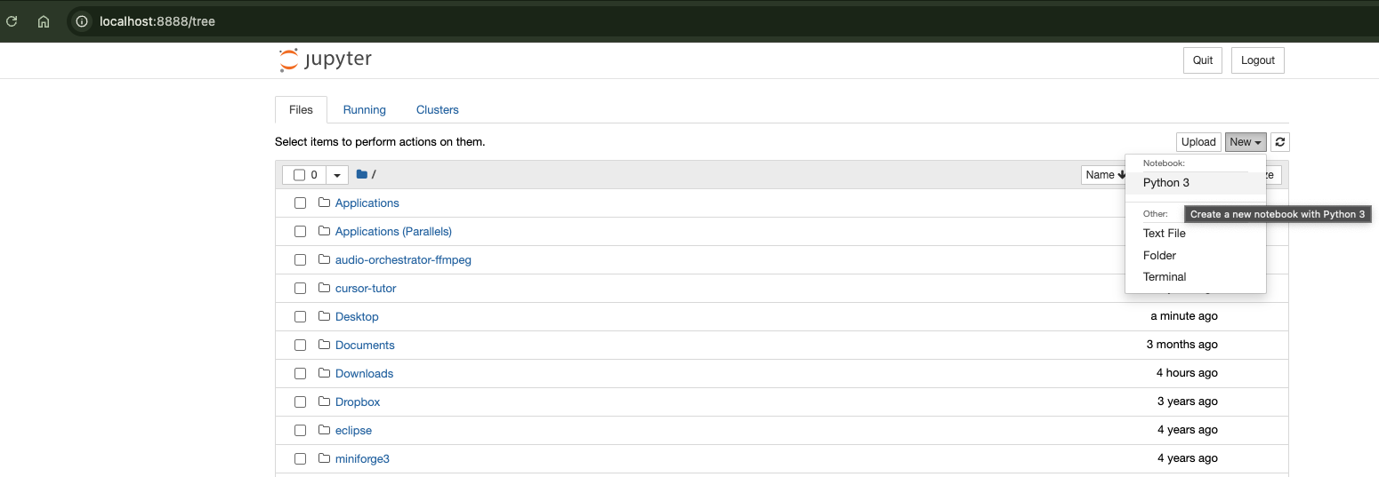
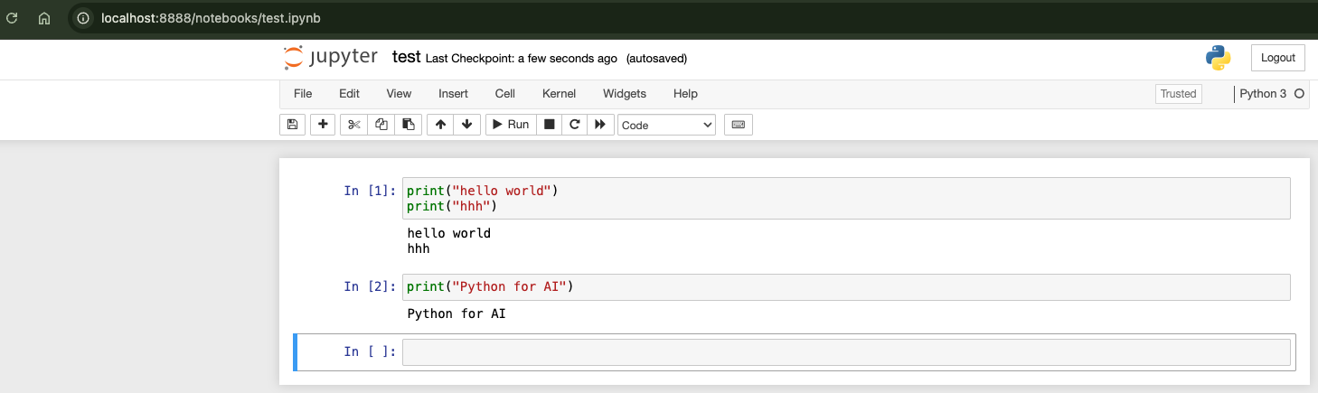
Getting started with Jupyter Notebook
Create a new .ipynb notebook file
Write and run code in individual cells
View the results instantly within the browser
E1. Environment Setup for Large Language Models

Slide 9
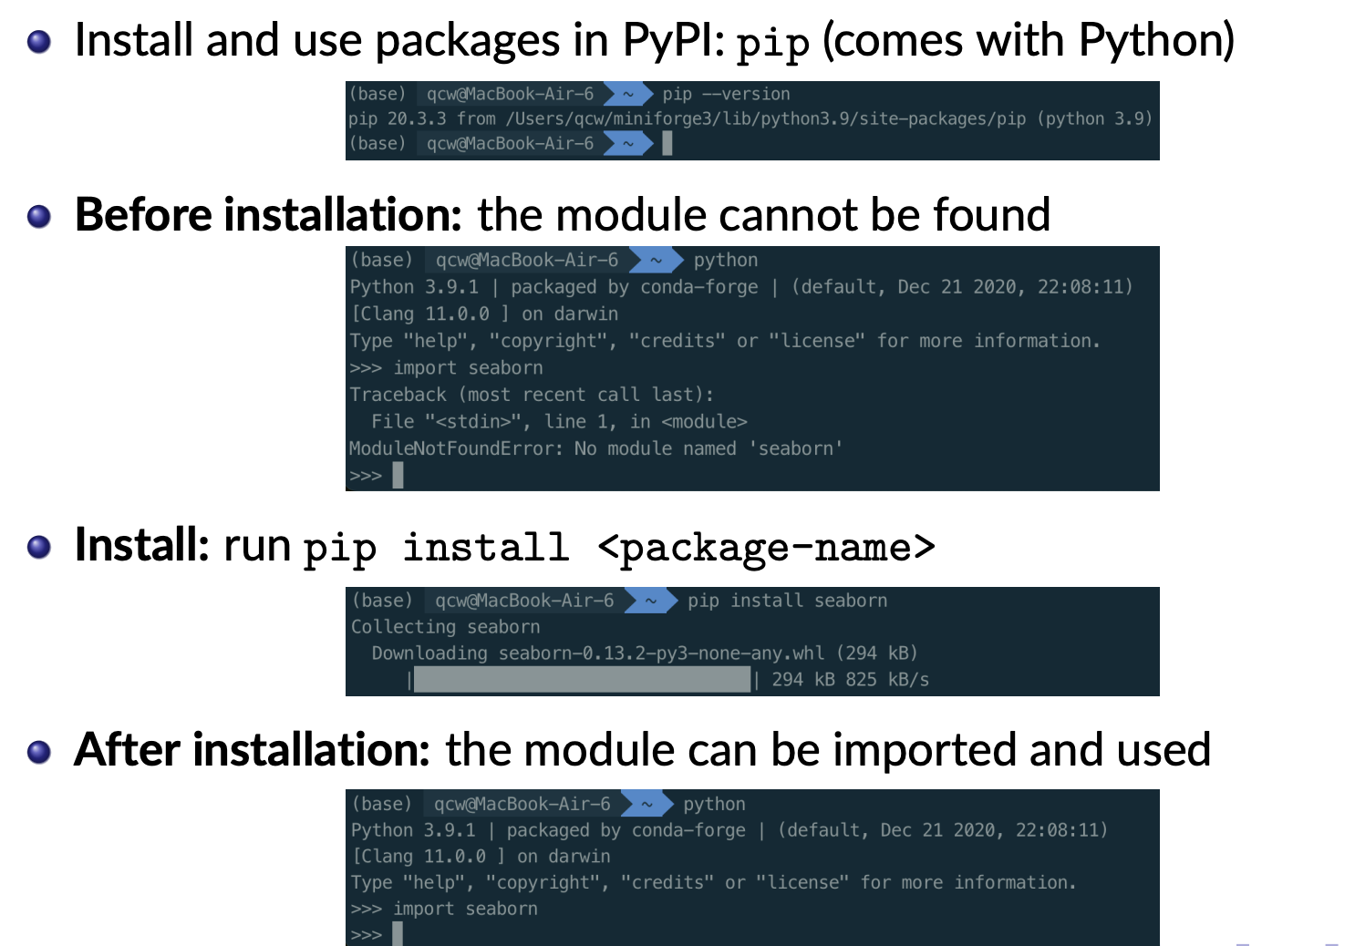
PyPI: Python Package Index
E1. Environment Setup for Large Language Models

Slide 10
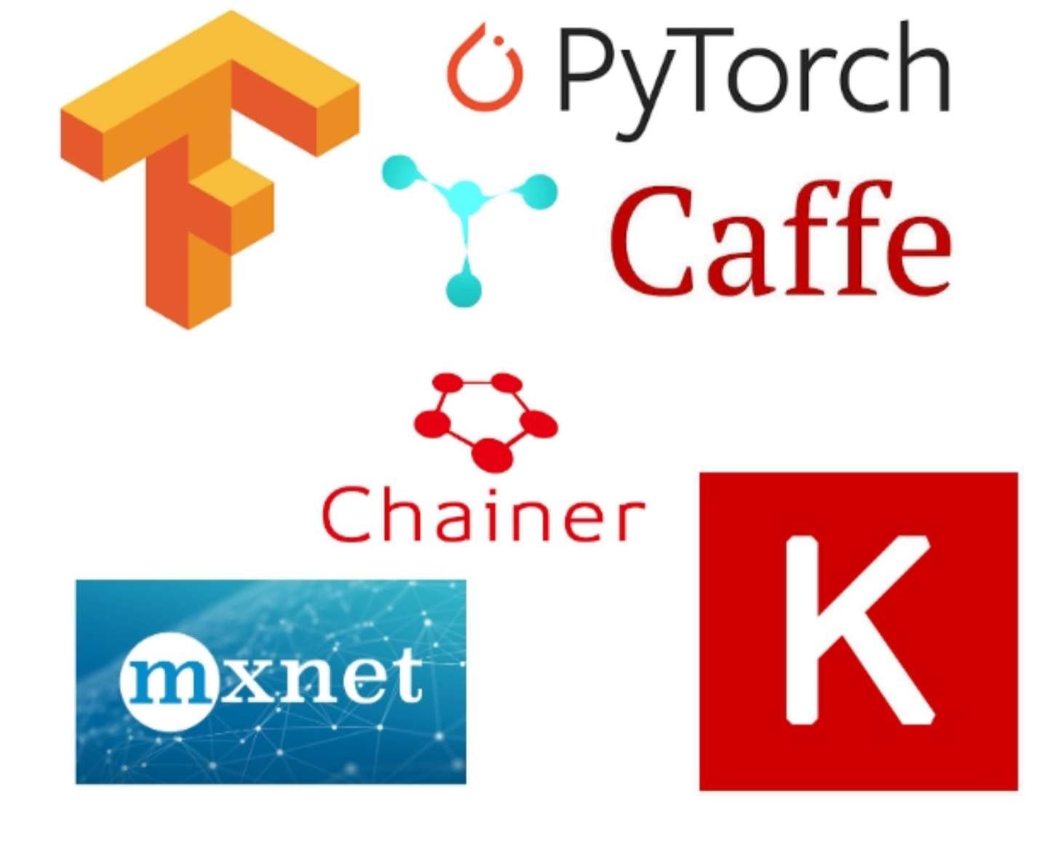
The Need for Deep Learning Frameworks
Building a deep learning model involves:
Customizing the structure (units and edges).
Adapting data to the network’s input.
Training the model with a suitable optimizer.
(The model can be very large) – Accelerating the massive computations.
A Deep Learning Framework is a library that provides tools to assist developers in building and training deep learning models:
GPU Support
Automatic Diﬀerentiation (Autograd)
Built-in, optimized network layers and loss functions
E1. Environment Setup for Large Language Models

Slide 11
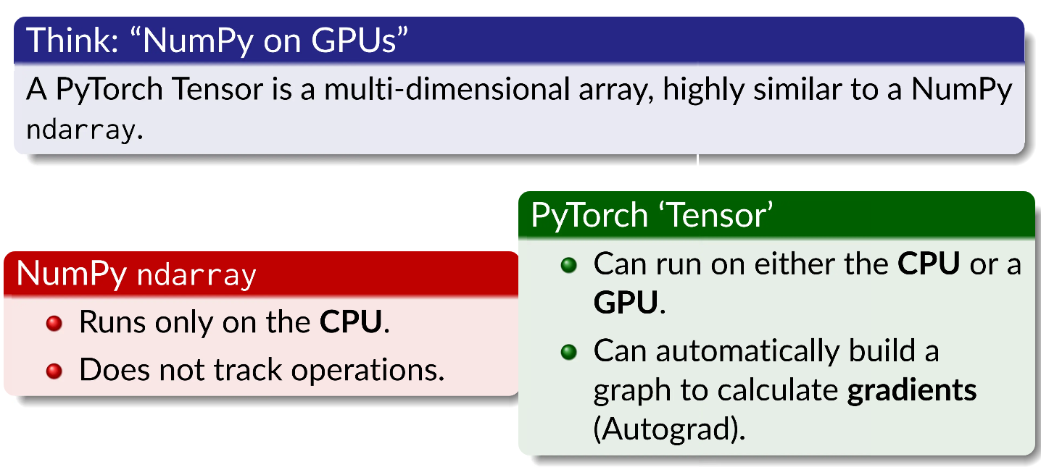
What is a PyTorch Tensor?
A torch.Tensor is the basic operand in PyTorch.
E1. Environment Setup for Large Language Models

Slide 12
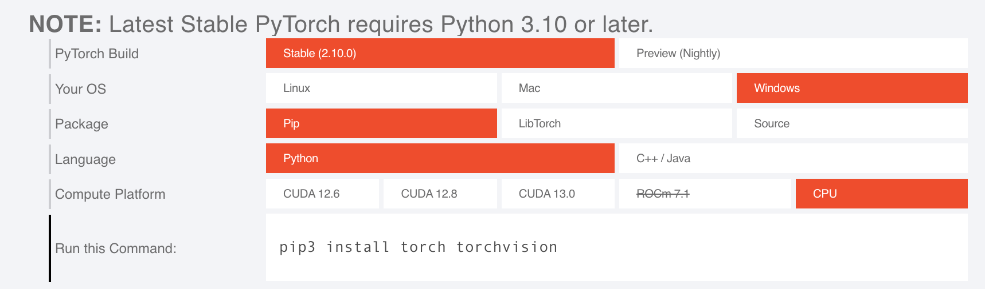
Install torch
Reference: https://developer.aliyun.com/article/1544711
E1. Environment Setup for Large Language Models

Slide 13
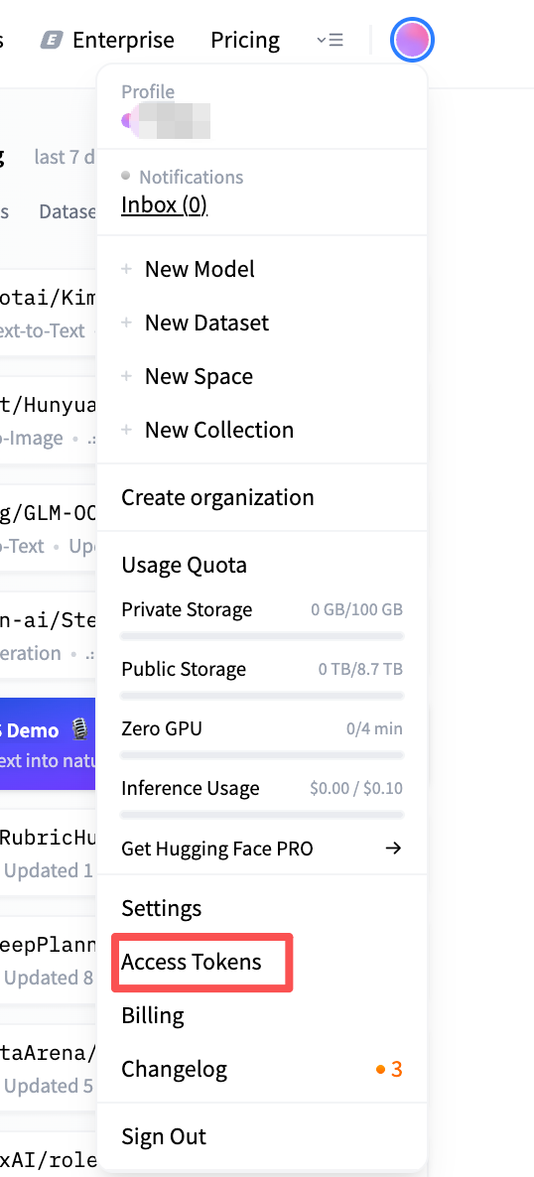

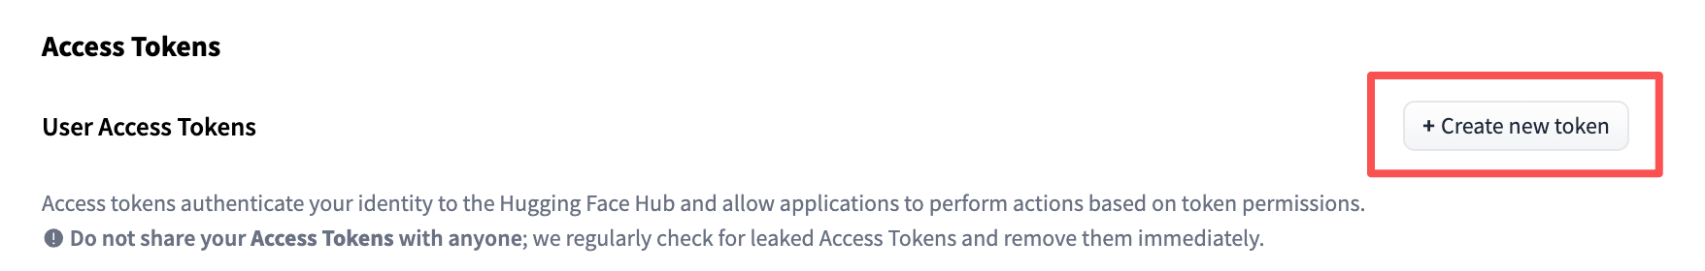
https://hf-mirror.com/
HuggingFace & ModelScope: Download model weights & datasets
What is Huggingface? https://huggingface.co
The Hugging Face Hub is a platform with over 2M models, 500k datasets, and 1M demo apps (Spaces), all open source and publicly available, in an online platform where people can easily collaborate and build ML together.
1
3
2
Please record or save elsewhere you own token!!! The token will be shown only once, and you need it later.
E1. Environment Setup for Large Language Models

Slide 14
HuggingFace & ModelScope: Download model weights & datasets
huggingface-cli it not only allows you to download models and data, but also lets you log in to Huggingface (using the token created before), upload models and data.
Install dependencies
pip install --upgrade huggingface_hub #depends on Python 3.8 or higher
export HF_ENDPOINT=https://hf-mirror.com
hf auth login # use the access token here
Basic Usage - Downloading Models
hf download gpt2 --local-dir gpt2
Basic usage - Downloading datasets
hf download --repo-type dataset lavita/medical-qa-shared-task-v1-toy
E1. Environment Setup for Large Language Models

Slide 15
HuggingFace & ModelScope: Download model weights & datasets
ModelScope （魔搭社区）
Install dependencies
pip install modelscope
Basic Usage - Downloading Models
modelscope download gpt2 --local-dir gpt2
Basic usage - Downloading datasets
modelscope download --repo-type dataset lavita/medical-qa-shared-task-v1-toy
huggingface package for using the model & dataset
Install dependencies
pip3 install torch torchvision #for cpu
# https://pytorch.org/
E1. Environment Setup for Large Language Models

Slide 16
HuggingFace transformer Package for Using the Model
Install dependencies
pip install transformers
In python script
from transformer import AutoModelForCausalLM, AutoTokenizer
Basic Usage – Loding the Tokenizer & Model
tokenizer = AutoTokenizer.from_pretrained(model_name)
model = AutoModelForCausalLM.from_pretrained(model_name,device_map="auto")
E1. Environment Setup for Large Language Models

Slide 17
A simple example using the downloaded model
import torch
from transformers import AutoModelForCausalLM, AutoTokenizer # 1. Load the model and tokenizer
model_name = "Qwen/Qwen2.5-0.5B"
# Initialize the tokenizer: acts as a translator between human text and the numbers (tokens) the model understands.
tokenizer = AutoTokenizer.from_pretrained(model_name)
# Download and load the neural network weights.
# `device_map="auto"` automatically checks your hardware and places the model on the device
model = AutoModelForCausalLM.from_pretrained(model_name, device_map="auto")
# 2. Prepare the input
# (Note: In standard practice, you usually add `return_tensors="pt"` inside the tokenizer call so it outputs PyTorch tensors).
prompt = "How should we evaluate the creativity of large language models?"
inputs = tokenizer(prompt).to(model.device)
# 3. Generate (inference)
# `torch.no_grad()` tells PyTorch to temporarily stop tracking.
# Turning this off saves significant memory since we are only generating text.
with torch.no_grad():
#Using **inputs is exactly the same as manually typing this out: #model.generate(input_ids=tensor([[...]]), attention_mask=tensor([[...]])
outputs = model.generate(**inputs, max_new_tokens=100)
# 4. Decode the output
print(tokenizer.decode(outputs[0], skip_special_tokens=True))
E1. Environment Setup for Large Language Models

Slide 18
Outline
E1. Environment Setup for Large Language Models
E1.1 Python & Jupyter notebook & Pytorch & Huggingface
E1.2 Large Language Model in Website
E1.3 Large Language Model in Terminal (e.g. Claude Code)
E1. Environment Setup for Large Language Models

Slide 19
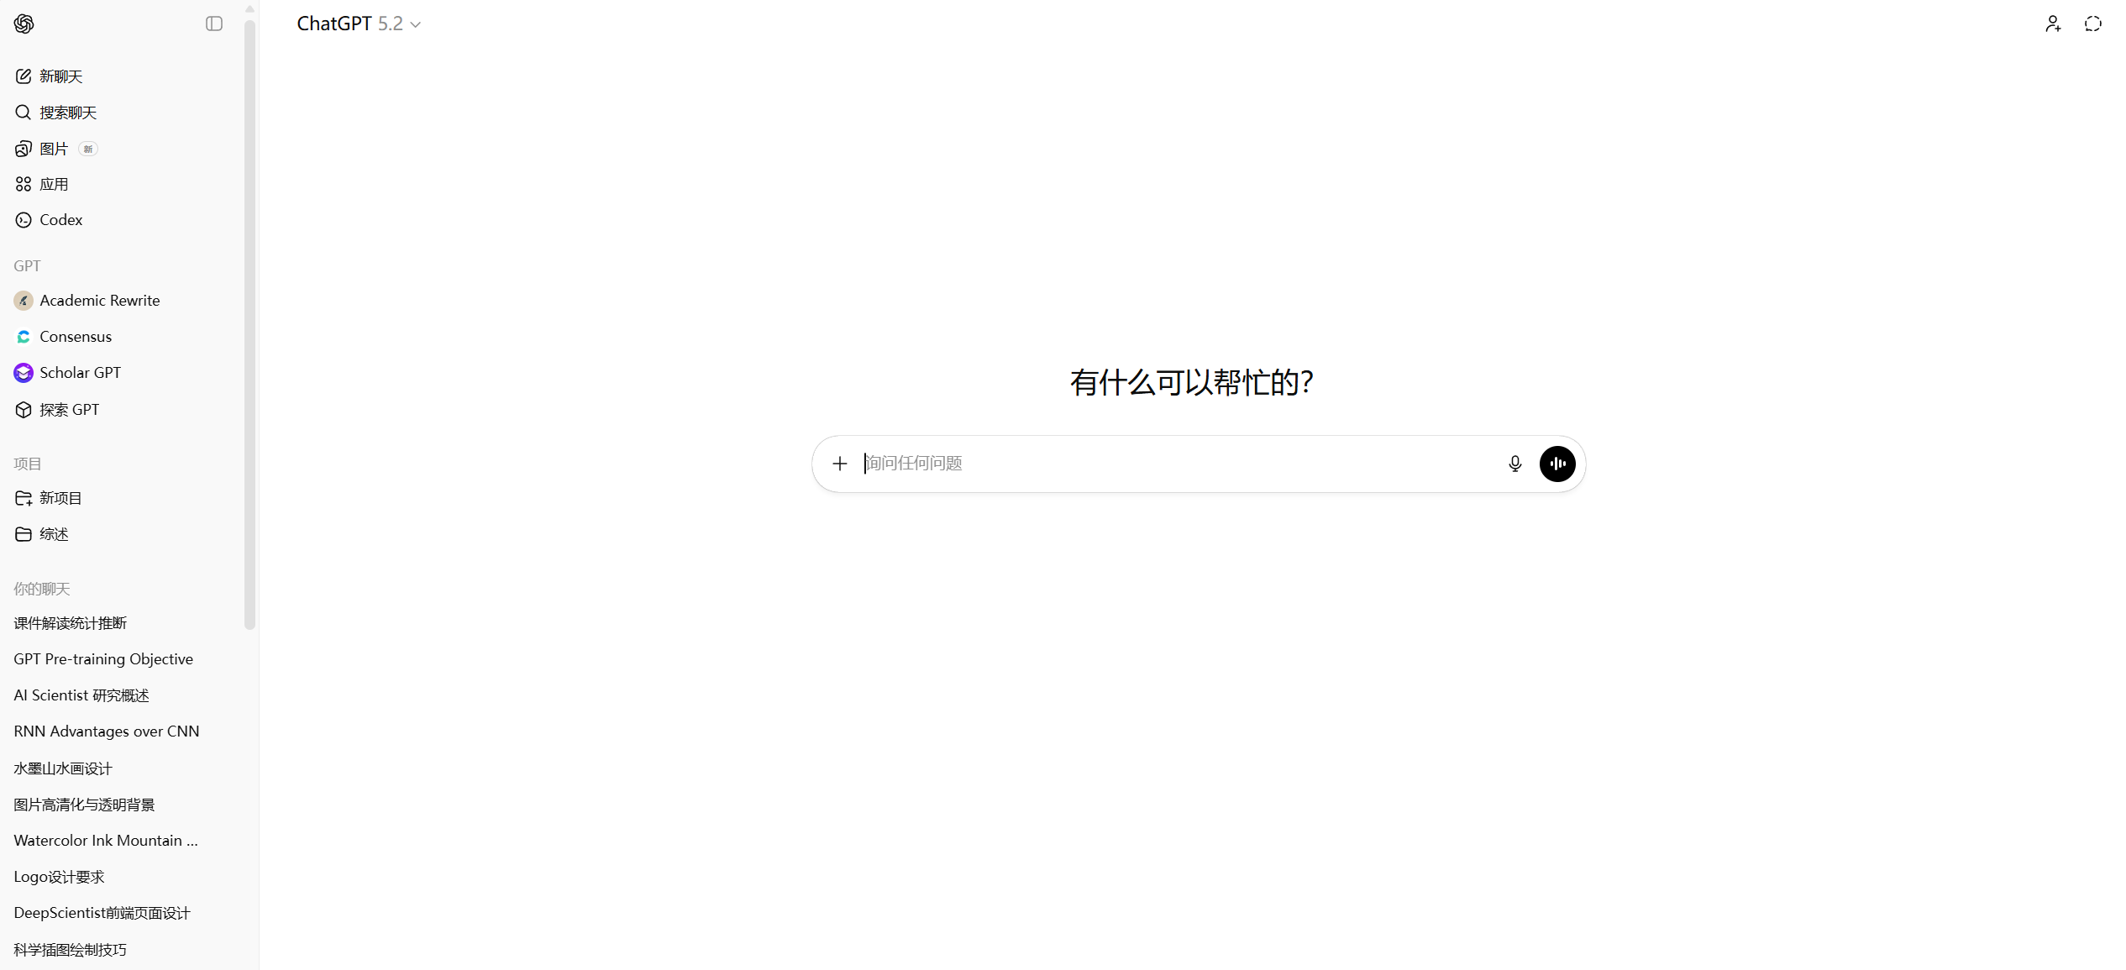
ChatGPT
E1. Environment Setup for Large Language Models Large Language Model in Website

Slide 20
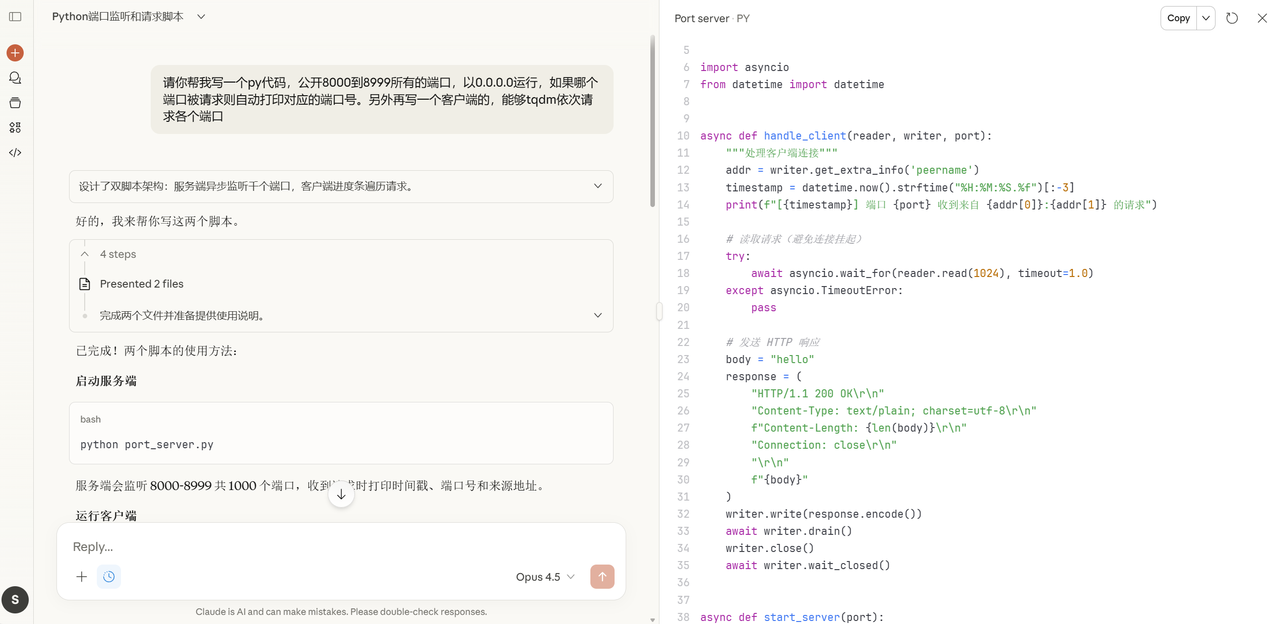
Claude
E1. Environment Setup for Large Language Models Large Language Model in Website

Slide 21
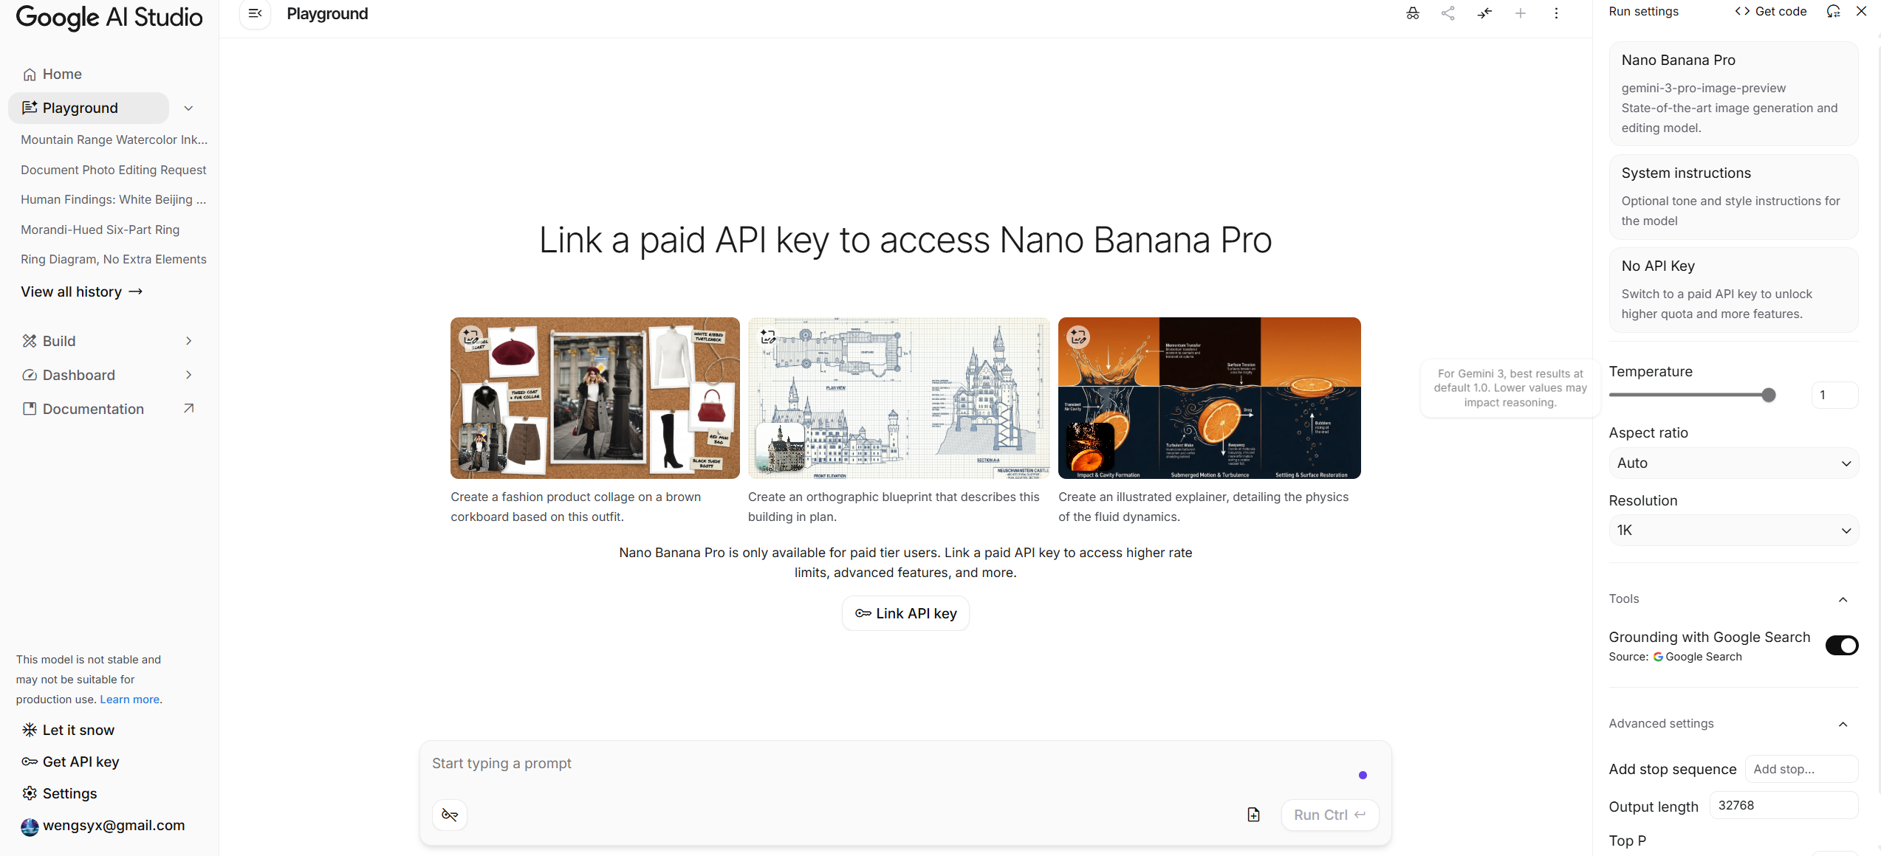
Gemini
E1. Environment Setup for Large Language Models Large Language Model in Website

Slide 22
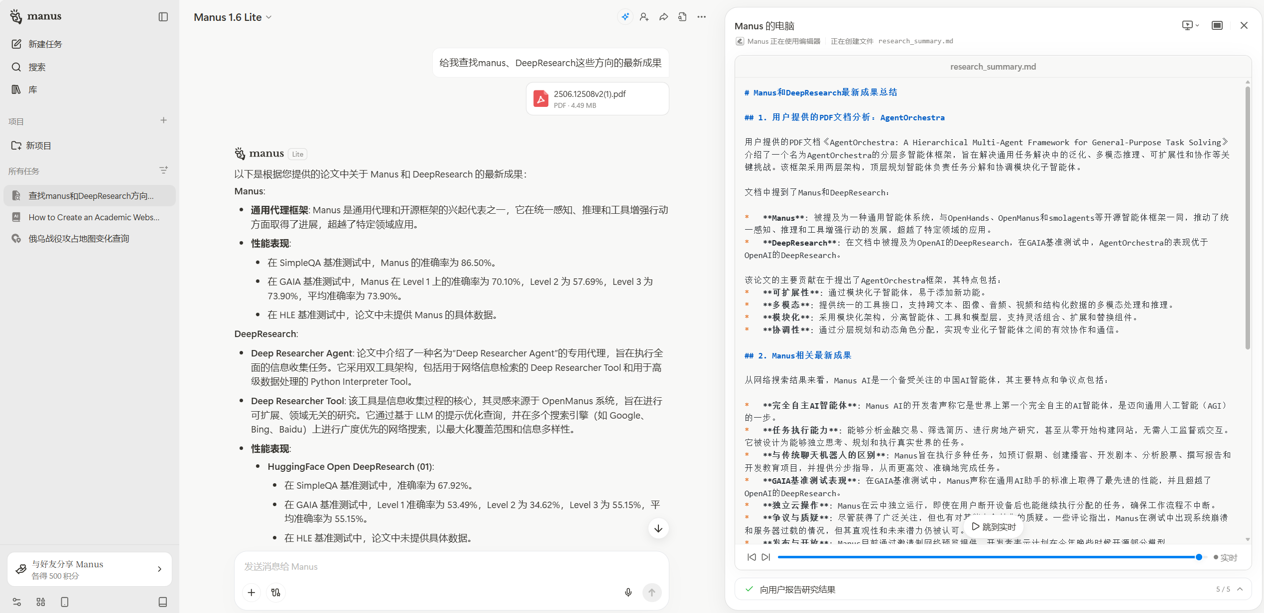
Gemini
Manus
E1. Environment Setup for Large Language Models Large Language Model in Website

Slide 23
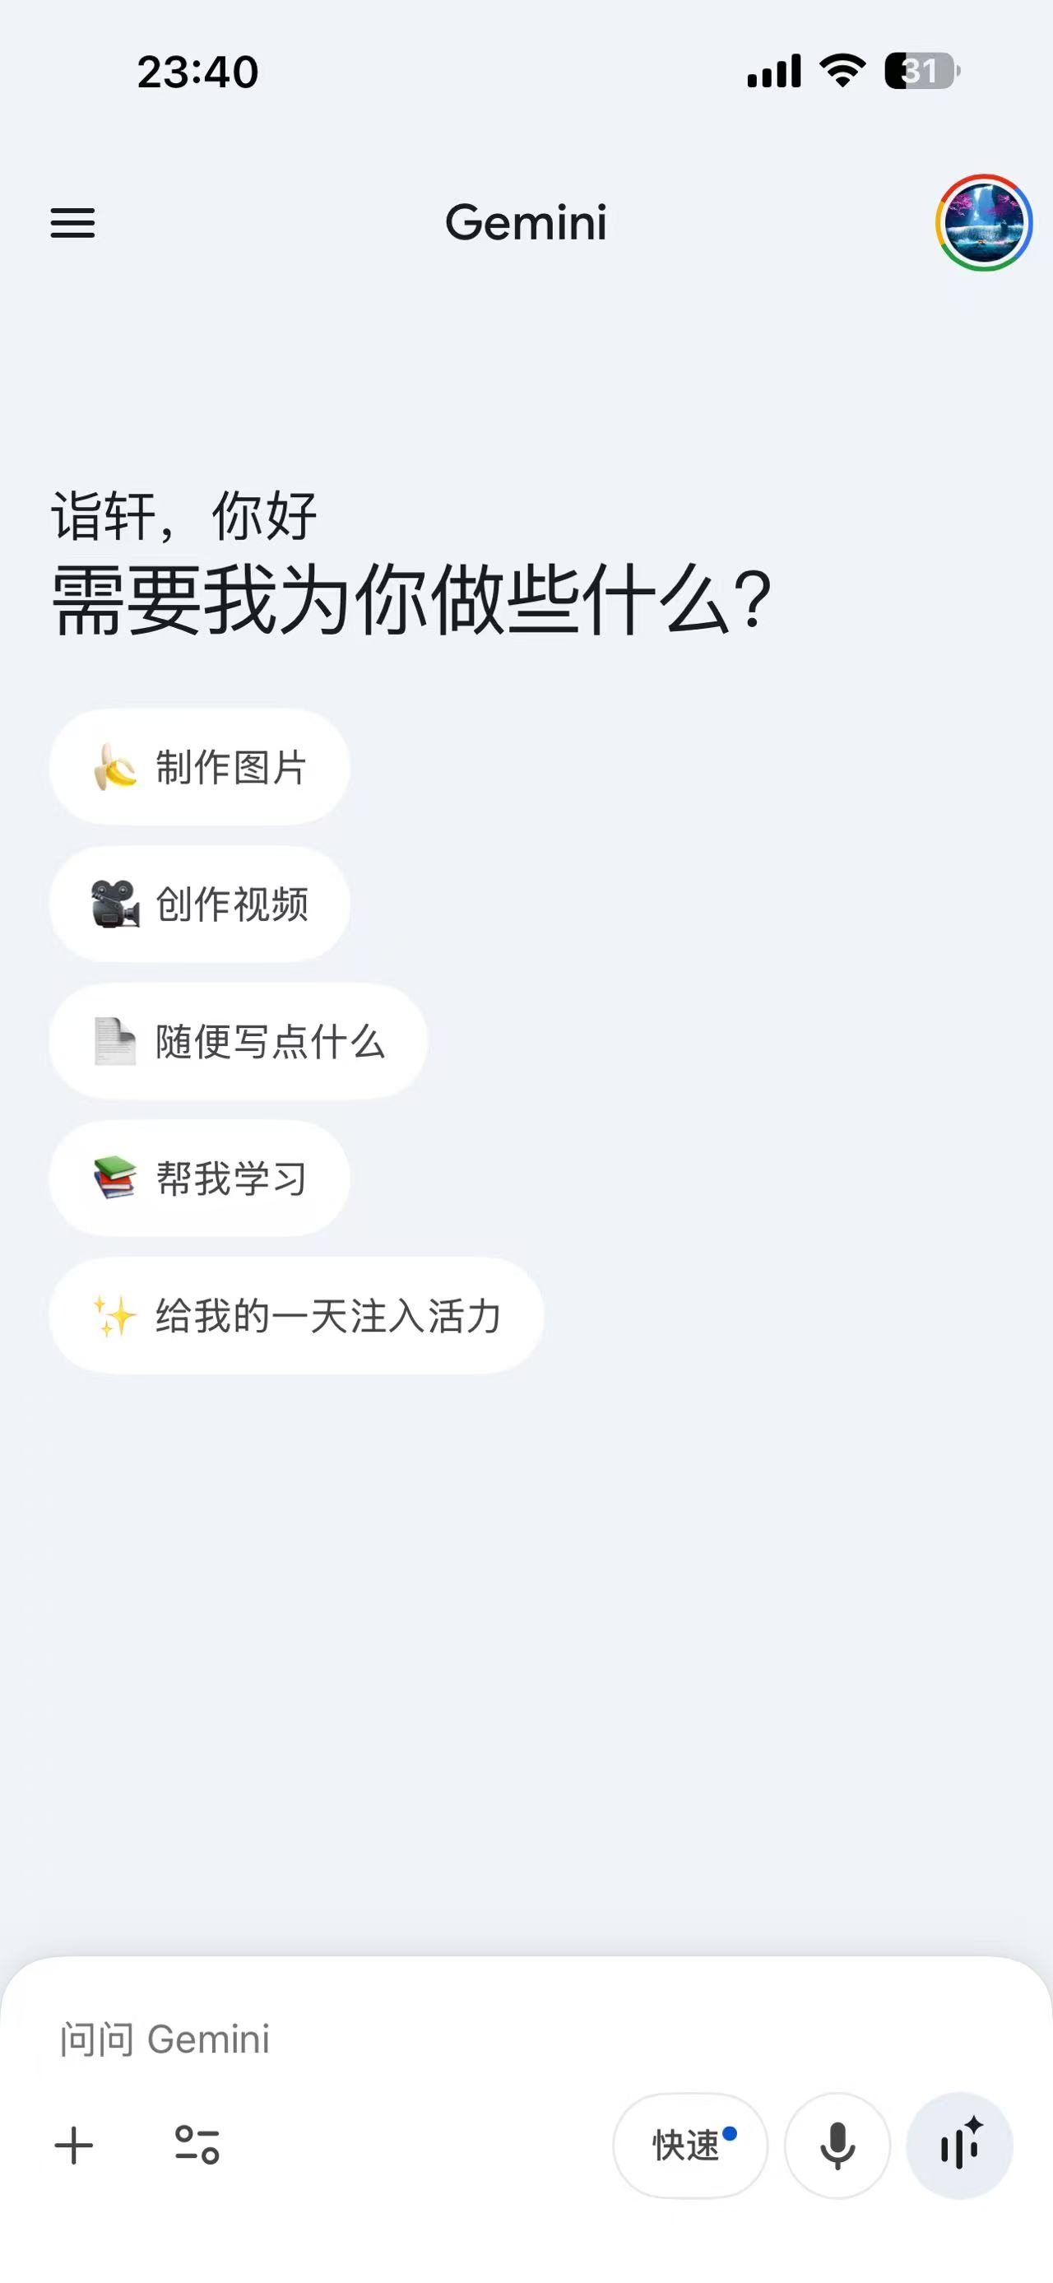
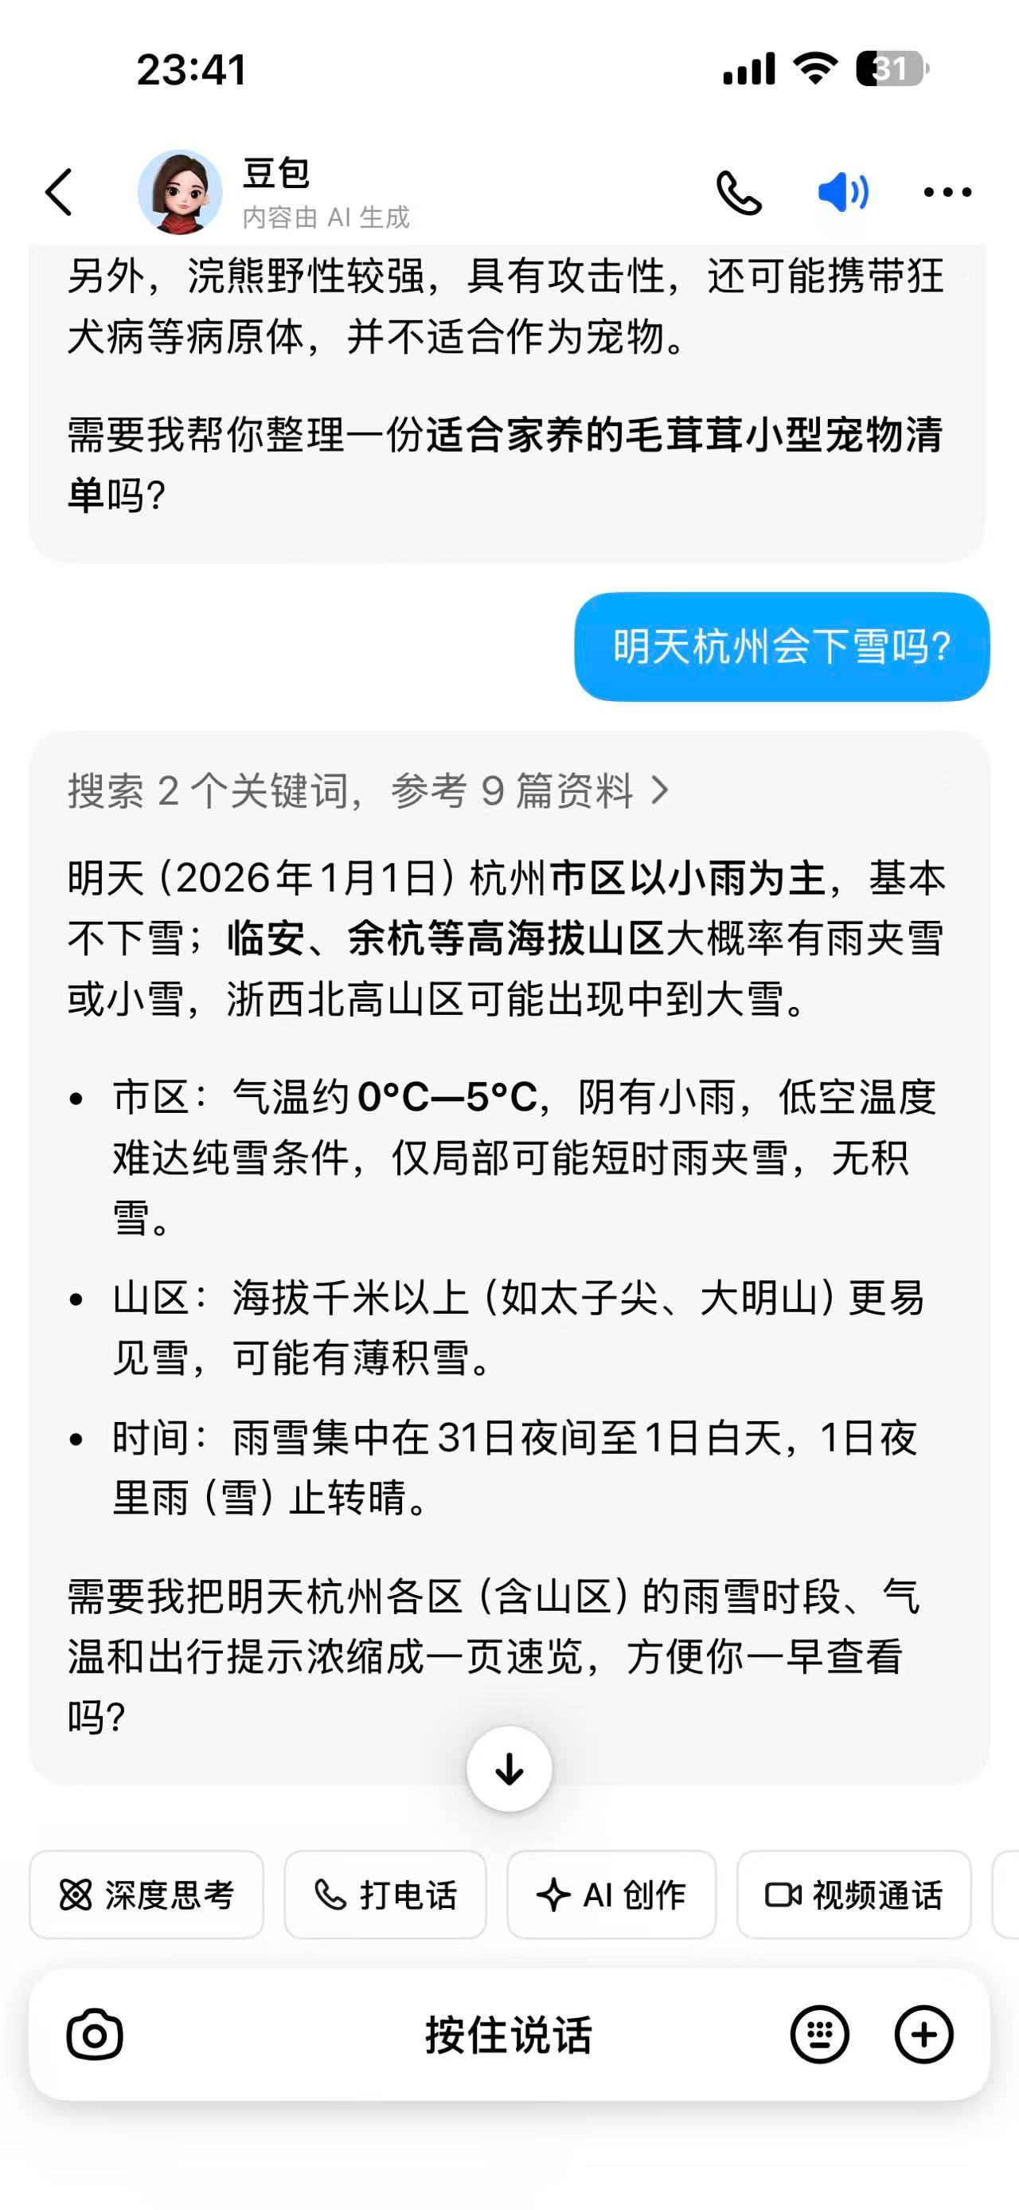
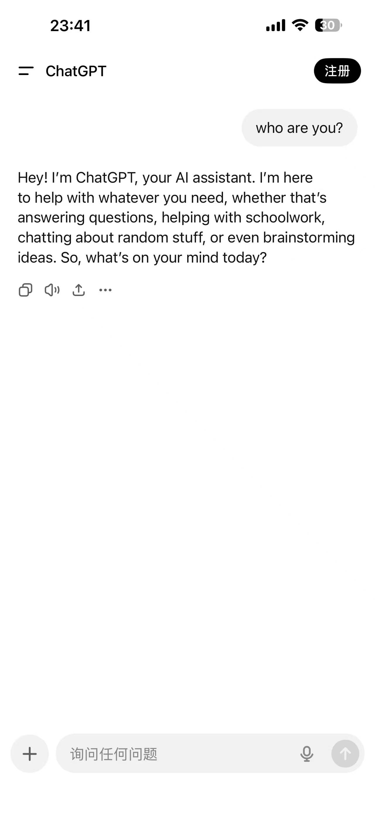
Gemini
doubao
ChatGPT
E1. Environment Setup for Large Language Models Large Language Model in Website

Slide 24
Capability | Typical Use Cases | Current Status / Availability
Text | Writing, Translation, Coding | Highly Mature. Supported by almost all versions (free & paid).
Image | Generating art (Text-to-Image), Analyzing photos | Mature. High-quality generation usually requires paid plans (e.g., GPT-Image, Gemini Nano Banana).
Documents & Data | Summarizing PDFs, Analyzing Excel/CSV files | Mature. Powerful productivity tools for handling large files.
Web Browsing | Real-time news, Fact-checking, Weather | Mature. Integrated with search engines (Google or Bing) for up-to-date info.
Video Generation | Creating short video clips from text | Limited / Experimental. High-end models (like Sora or Veo) are not yet fully available to the general public via standard web chat.
Video Analysis | Understanding & answering questions about uploaded videos | Gemini is notably strong. It can natively "watch" and analyze long video files.
E1. Environment Setup for Large Language Models Large Language Model in Website

Slide 25
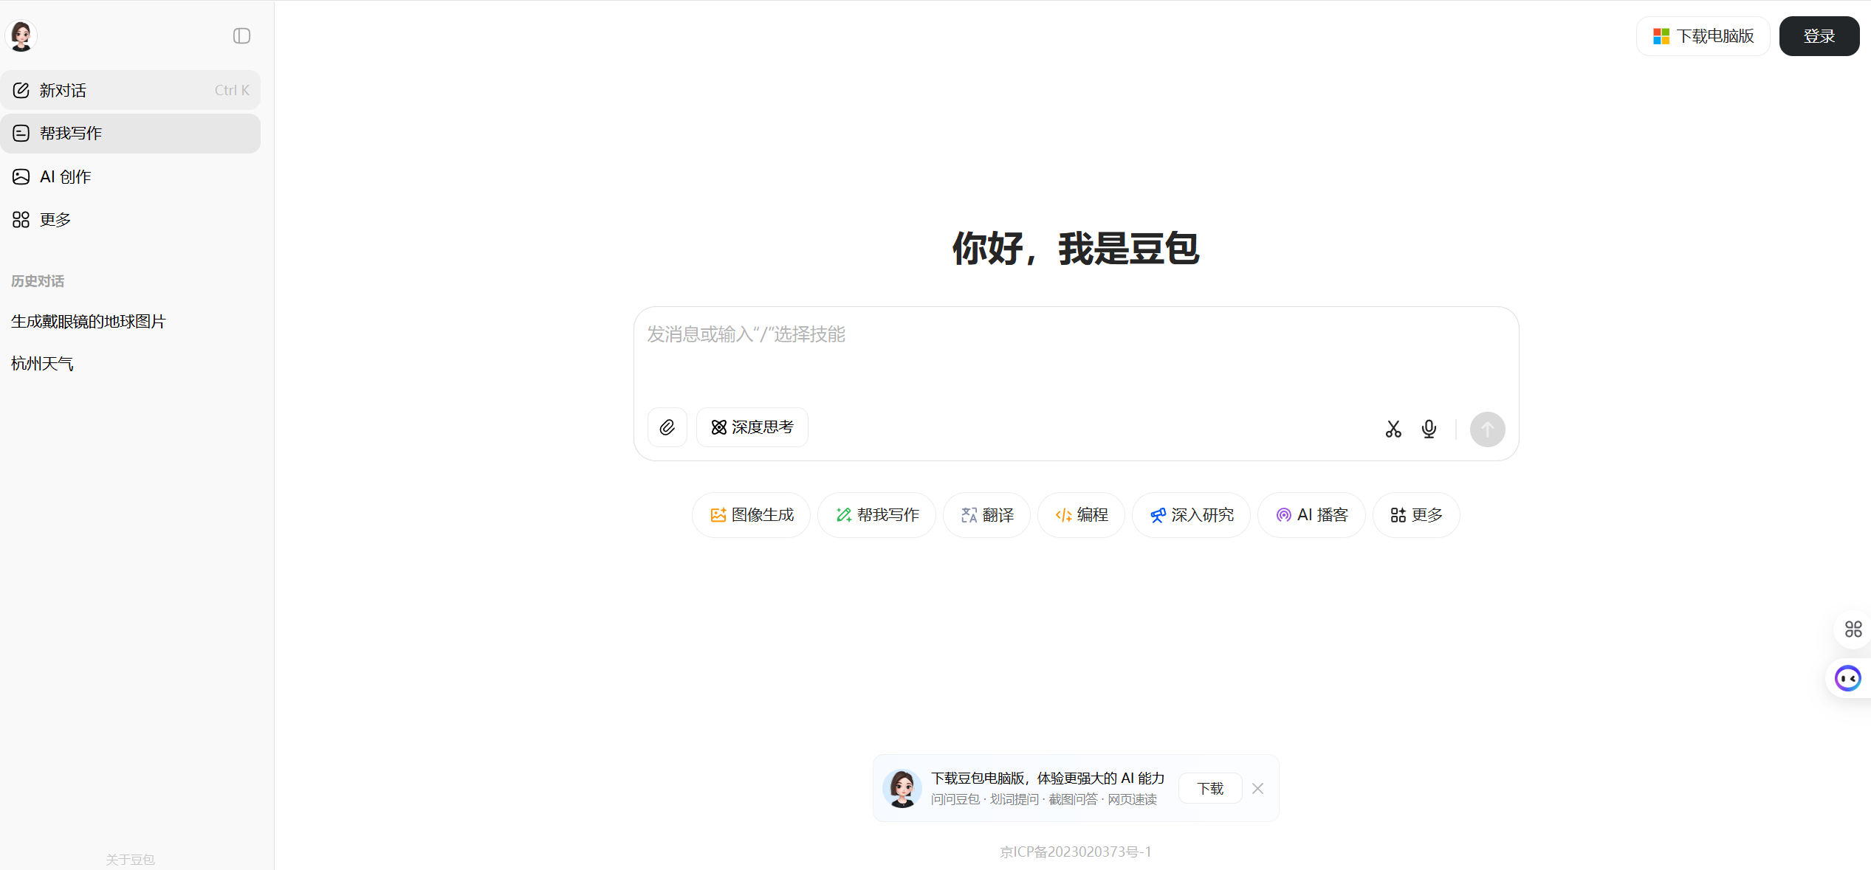
Task
ChatBot
-> doubao.com
-> Ask a question “Who are you”
E1. Environment Setup for Large Language Models Large Language Model in Website

Slide 26
Task
Reasoner
-> Ask a question
-> Check “Thinking”
-> Ask a question again
“Let $A$, $B$, $C$, and $D$ be points on the hyperbola $\frac{x^2}{20}- \frac{y^2}{24} = 1$ such that $ABCD$ is a rhombus whose diagonals intersect at the origin. Find the greatest real number that is less than $BD^2$ for all such rhombi.”
Answer: 480
E1. Environment Setup for Large Language Models Large Language Model in Website
Notes:
可以有一个小互动，让学生自己测试，分别是开启深度思考前和深度思考后

Slide 27
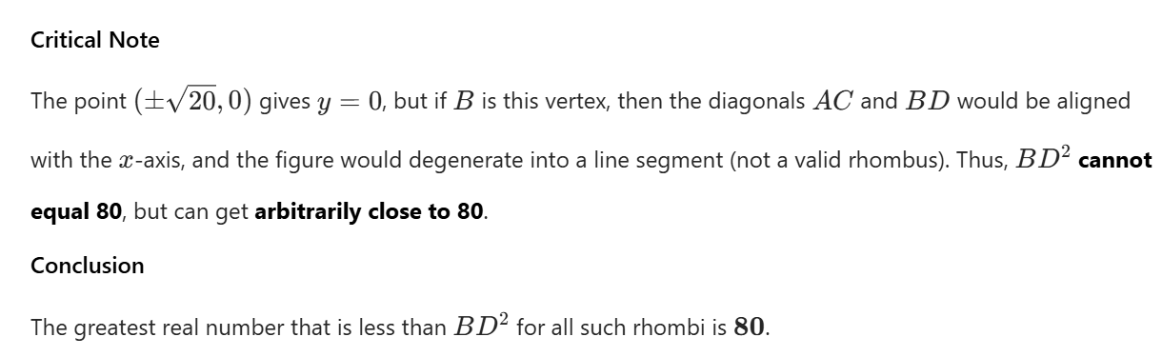
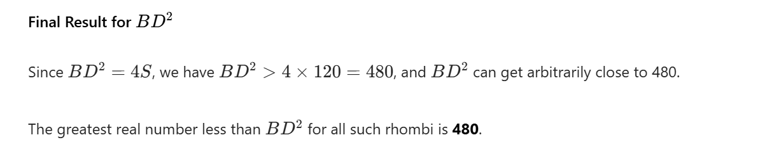
Task
Reasoner
Without
Thinking
❌
With
Thinking
✅
E1. Environment Setup for Large Language Models Large Language Model in Website

Slide 28
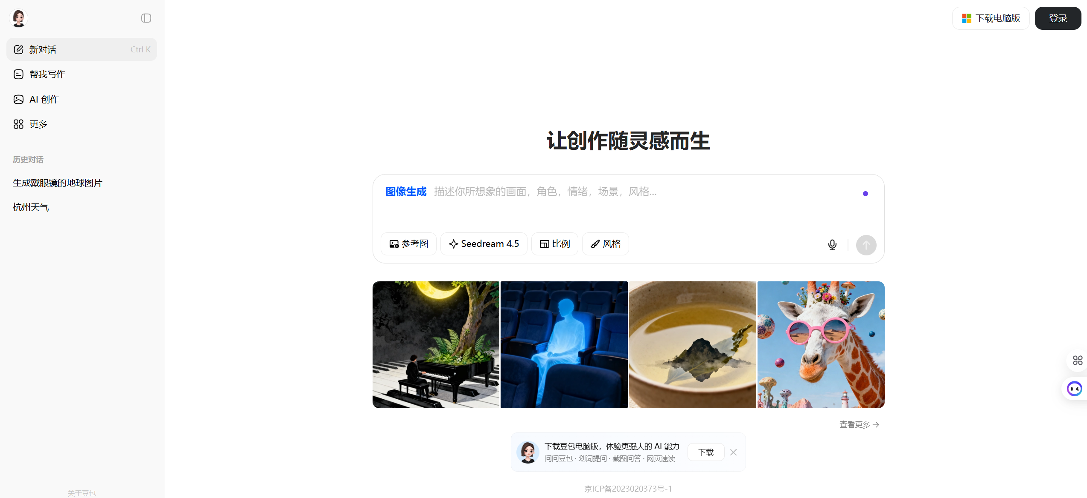
Task
Image Generate
-> Check “New” then “Image Generation (图像生成)”
-> Input “A globe wearing glasses”
E1. Environment Setup for Large Language Models Large Language Model in Website

Slide 29
Task
Agent
-> Check “New” then “Deep Research (深入研究)”
-> Input “What is Claude Code? How do you install and use it?”
E1. Environment Setup for Large Language Models Large Language Model in Website

Slide 30
End of E.1
Lecture 1 2026/02/27

